Slide 1
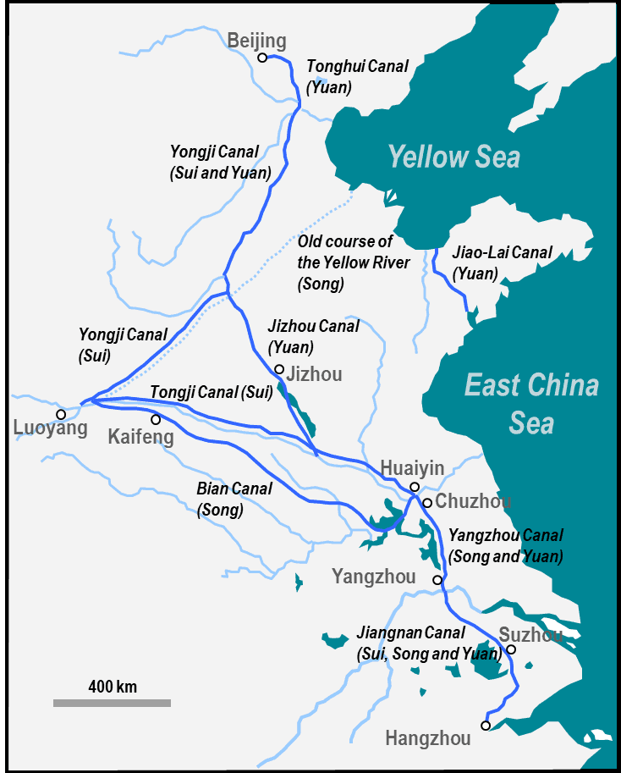
Grand Canal System
Reorganized under naval commander Chen Xuan
Linked the 2 most important river basins
Stop and Jot: Which river basins are linked?
Coastal travel bore significant risk
Turn and talk: What risks did the seas present?
Resulted in successful grain supply shipments between north and south

