Slide 1





Robert Smalls
1839-1915

Slide 2

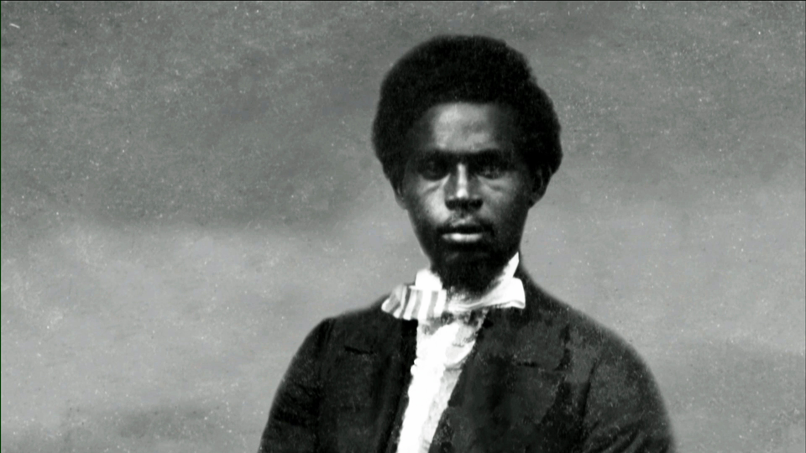

Celebrating Black Men
My race needs no special defense, for the past history of them provides them to be the equal of any people anywhere. All they need is an equal chance in the battle of life.
-Robert Smalls
Robert Smalls
What does this quote mean to you? (talk to your partner)

Slide 3
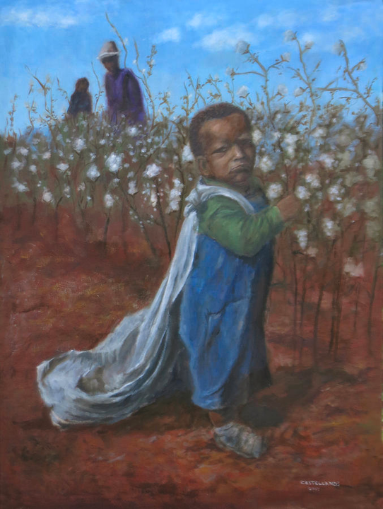
EArly Life
Born a slave April 5,1839 in Beaufort, SC
Son of Lydia Polite, a house slave for John K. McKee
Smalls was 12 years old, McKee sent him to Charleston to be hired out. He worked as a waiter in a hotel before eventually hiring out in the city’s docks.
At 17, married Hannah Jones,32, a slave hotel maid on December 24, 1856 and had a daughter named Elizabeth Lydia.

Slide 4
Vision & Mission
Smalls joined the navy to support the union. He became a skilled boat pilot and on May 12, 1862, he used his skills to steal the ship CSS Planter with his boat crew and family, who all were slaves. Having escaped into Northern territory, he was no longer a slave. He worked alongside the Union navy until the end of the Civil War.
After the war, Robert Smalls worked for the South Carolina state and national governments, and represented South Carolina in the U.S. Congress for five terms.
Smalls also fought to secure full citizenship and equality for Black Americans.

