Slide 1
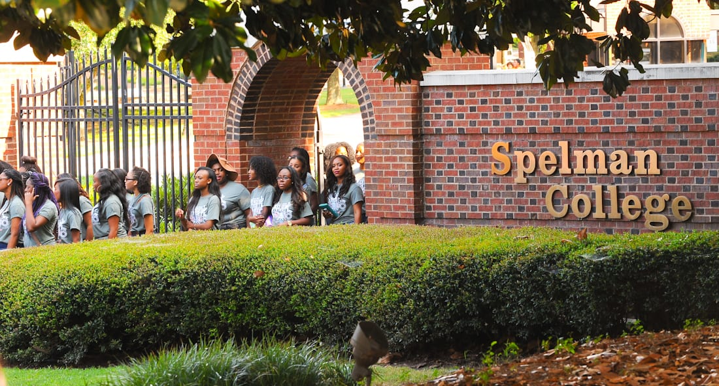
Spelman College
The oldest historically Black college for women in America

Slide 2
History
Established: April 11, 1881; 142 years ago
Motto: Our Whole School for Christ
Type: HBCUs, women’s liberal arts college
1881: Founded as Atlanta Baptist Female Seminary by Sophia B. Packard and Harriet E. Giles
1924: Spelman College

Slide 3
Spelman College Mission Statement
“Spelman College, a historically Black college and a global leader in the education of women of African descent, is dedicated to academic excellence in the liberal arts and sciences and the intellectual, creative, ethical, and leadership development of its students. Through diverse learning modalities, Spelman empowers the whole person to engage the many cultures of the world and inspires a commitment to positive social change.”
Source: About us, spelman.edu/about-us.

Slide 4
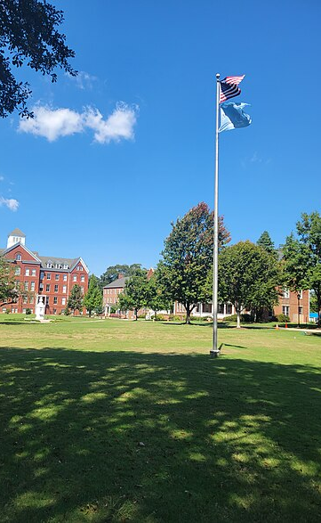
Spelman College Today
more than 2,100 students from 43 states and 10 foreign countries
76 percent graduation rate (average over six years), one of the best in the nation
empower women to engage the many cultures of the world and inspire a commitment to positive social change through service
“We are dedicated to academic excellence in the liberal arts and sciences and the intellectual, creative, ethical and leadership development of our students.”
Source: About us, spelman.edu/about-us.

