Slide 1
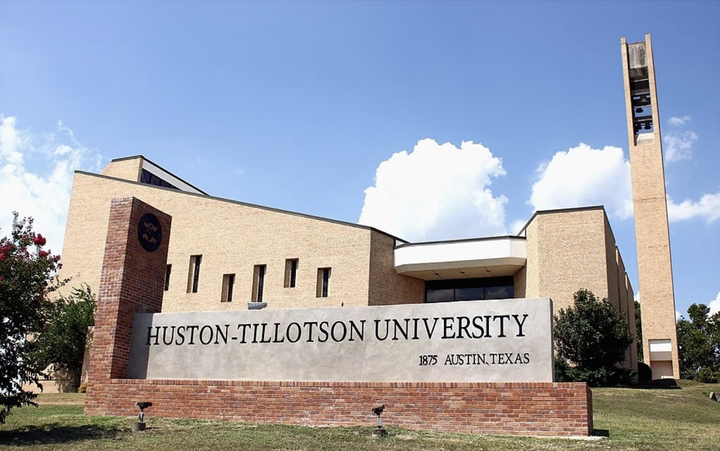

Slide 2
Founding of Huston-Tillotson University-Austin
The roots of Tillotson College date back to 1875 and build upon work of the Freedmen's Aid Society of the American Missionary Association of the Congregational churches (now United Church of Christ). Chartered in 1877 as Tillotson Collegiate and Normal Institute, the school began classes on January 17, 1881.

Slide 3
Significance in the Late 1800s
The collaboration of diligent black people and concerned white philanthropists from the North was the impetus behind the formation of what is now Huston-Tillotson University in Austin, Texas. Chartered in 1877 and opened in 1881 under the name of Tillotson Collegiate and Normal Institute by the American Missionary Association in Austin, Texas, Huston-Tillotson University was among the earliest all-black private colleges established in the Lone Star State. Today Huston-Tillotson University is affiliated with the United Methodist Church and the United Church of Christ.
In the 1870s George Jeffrey Tillotson, a Congregational minister from Connecticut, traveled to the Southwest in search of land to establish a school for African Americans. After finding several acres of land in Austin, Tillotson succeeded in raising $16,000.00 for an educational enterprise. While Tillotson was busy garnering funds for the project that bore his name, Samuel Huston, a wealthy landowner from Marengo, Iowa, contributed $9,000.00 to establish a co-educational school for African Americans in the same city. Originally known as the West Texas Conference School, the school’s name was changed to Samuel Huston College in 1890 and opened its doors in 1900.

Slide 4
Huston-Tillotson University-Austin Today
Huston-Tillotson University is affiliated with The United Methodist Church, the United Church of Christ, and the United Negro College Fund (UNCF). HT, in Austin, is a coeducational college of liberal arts and sciences, operating jointly under the auspices of the American Missionary Association of the United Church of Christ, and the Board of Education of The United Methodist Church. Huston-Tillotson College officially changed its name to Huston-Tillotson University on February 28, 2005. Huston-Tillotson College was formed by the merger of Samuel Huston College and Tillotson College, which was effective on October 24, 1952. Huston-Tillotson College remained primarily a black college after the merger, although there were no restrictions as to race. Huston-Tillotson University awards undergraduates, four year degrees in business, education, the humanities, natural sciences, social sciences, science and technology. A multi-cultural, multi-ethnic, and multi-faith institution, the University welcomes students of all ages, races, and religions.

