Slide 1
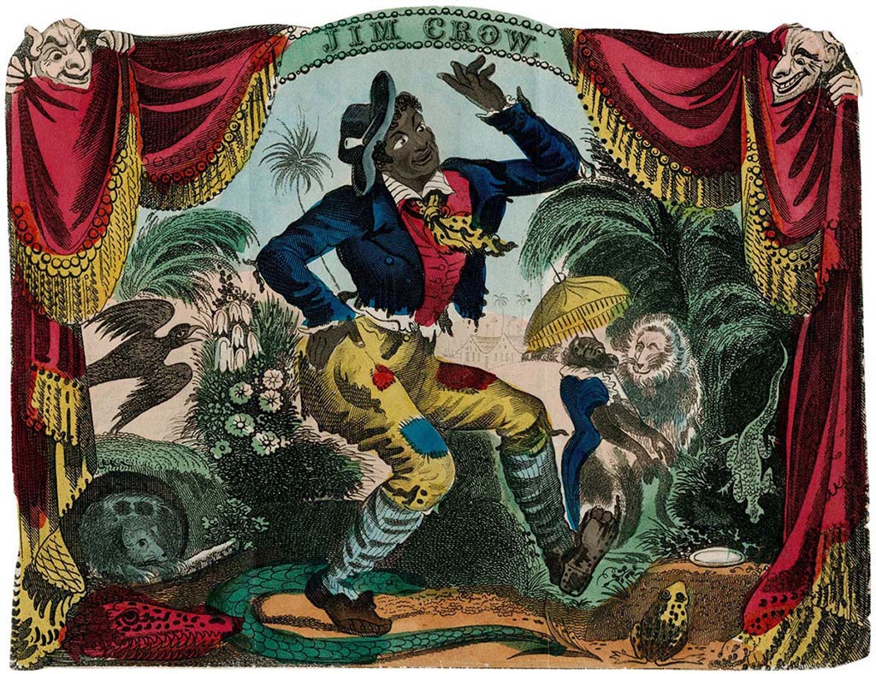
Jim Crow: A History

Slide 2
“Jim Crow”
https://jimcrowmuseum.ferris.edu/who/index.htm
Thomas Dartmouth Rice, a struggling white actor, became famous by performing in blackface makeup as "Jim Crow," an exaggerated, highly stereotypical black character. By 1838, the term "Jim Crow" was being used as a collective racial epithet for black people, not as offensive as nigger, but as offensive as coon or darkie. The popularity of minstrel shows aided the spread of Jim Crow as a racial slur. By the end of the 19th century, Jim Crow was being used to describe laws and customs that oppressed black people.

Slide 3
Plessy v. Ferguson (1896)
Establishes the legal precedent for segregation
“Separate but equal” was never equal
Not overturned until 1954: Brown v. Board of Education

Slide 4
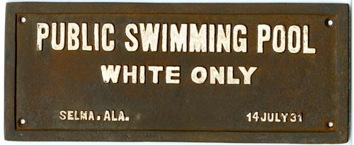
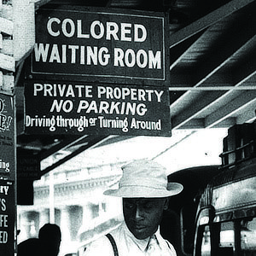
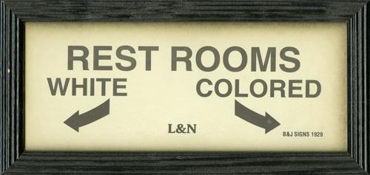
Jim Crow: Separate Public Accommodations

Slide 5
The Ku Klux Klan enforced white supremacy and Jim Crow laws through violence
Founded in 1865, Pulaski, TN
1920s Resurgence: nearly 4 million Klansmen

Slide 6
Jim Crow = Nationwide
1949 Map

Slide 7
1954: Brown v. Board of Education of Topeka Kansas overturns Plessy v. Ferguson

Slide 8
The Little Rock Nine (1957)
The Little Rock Nine, the first nine students to enter Little Rock’s Central High School, encounter violent white backlash.
Other attempts to desegregate public schools following the Brown v. Board decision likewise face a strong white backlash.
As of 1964, less than 2% of all southern public schools are desegregated.

Slide 9
Challenging Segregation: The Montgomery Bus Boycott (1955-1956)
Interactive Experience of the Montgomery Bus Boycott:
https://www.civilrightsmuseum.org/before-the-boycott

Slide 10
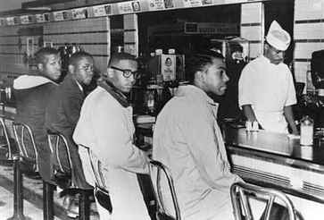
Challenging Segregation: The Greensboro Sit-Ins (1960)
Interactive Experience of the Greensboro Sit-In https://educate.civilrightsmuseum.org/StandingUp/index.html

Slide 11
Civil Rights Act of 1964
Prohibits segregation in all public facilities
The end of Jim Crow?

Slide 12
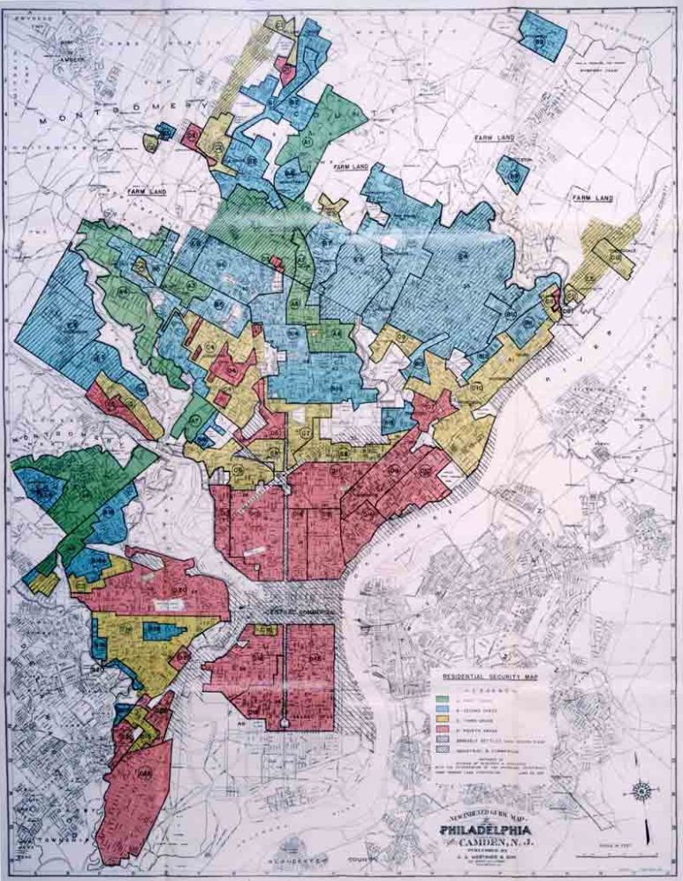
Jim Crow Persists: “Redlining”
HOLC Security Maps
Rating system
Adopted by Federal Housing Administration & financial lending institutions: 1940s-1960s
Results:
Black inner cities
All-white suburbs

Slide 13
Jim Crow Persists: Backlash vs. Desegregated Schools Anti-Busing Rally, South Boston, 1975

Slide 14
Jim Crow Today
Voter Suppression
Police Brutality
Mass Incarceration
Racial Profiling
Segregated Schools
Segregated Neighborhoods
What other examples of Jim Crow persist?

