Slide 1
Jim Crow Era
Understanding Jim Crow Laws

Slide 2
Today’s class
Understanding Jim Crow Laws
Using primary documents and images

Slide 3
“One-Way Ticket”
I am fed up
With Jim Crow laws,
People who are cruel
And afraid,
Who lynch and run,
Who are scared of me
And me of them.
—— Langston Hughes

Slide 4
Jim Crow Laws
The Jim Crow Laws were state and local laws enacted in the Southern United States between the 1870s and the 1960s that enforced racial segregation.

Slide 5
Jim Crow Laws
Enacted by white-dominated state legislatures
Led to the disenfranchisement of economic and political rights that African Americans had fought for during the Reconstruction era
“Used intimidation tactics to suppress Black voters”

Slide 6
So-called “separate but equal” doctrine
RACIAL DISCRIMINATION
RACIAL INEQUALITY
Institutionalized economic, educational, political disadvantages
“Second Class Citizen”

Slide 7
“One-Way Ticket”
I am fed up
With Jim Crow laws,
People who are cruel
And afraid,
Who lynch and run,
Who are scared of me
And me of them.
—— Langston Hughes

Slide 8
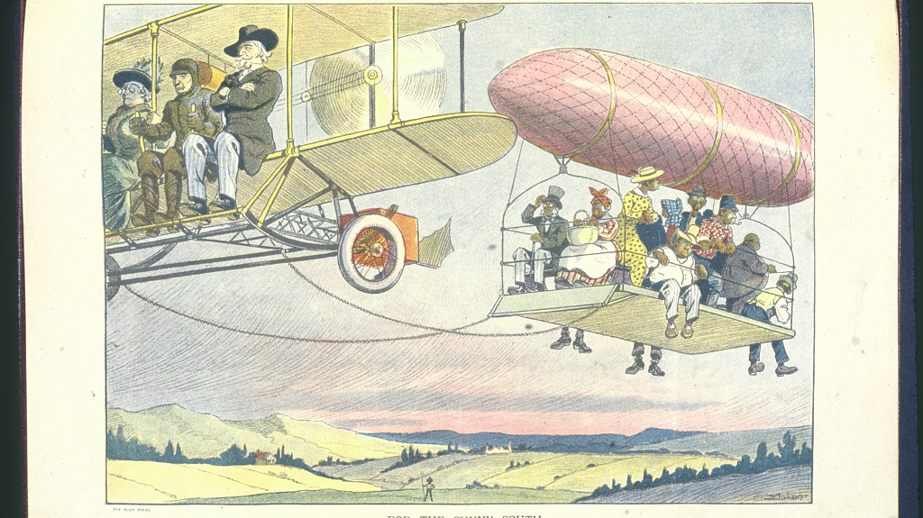

Slide 9
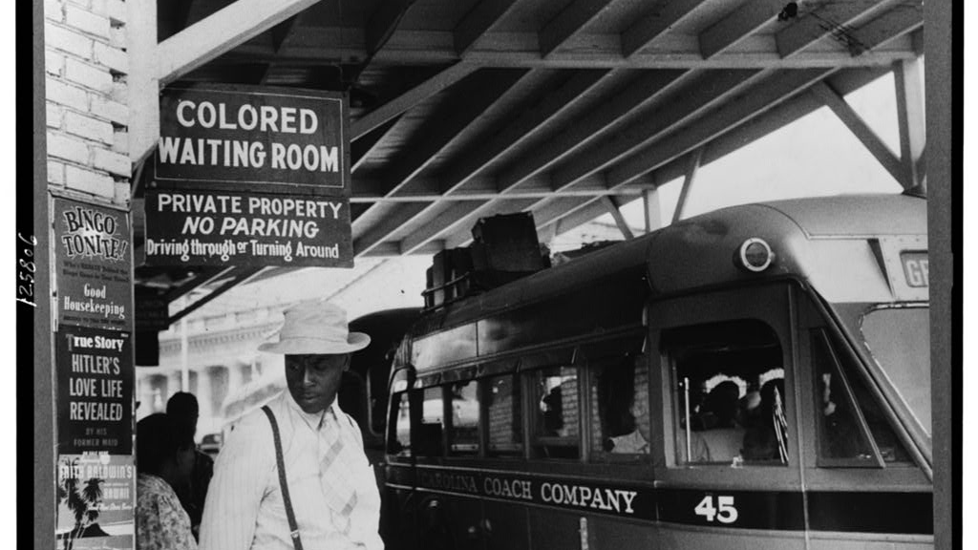

Slide 10
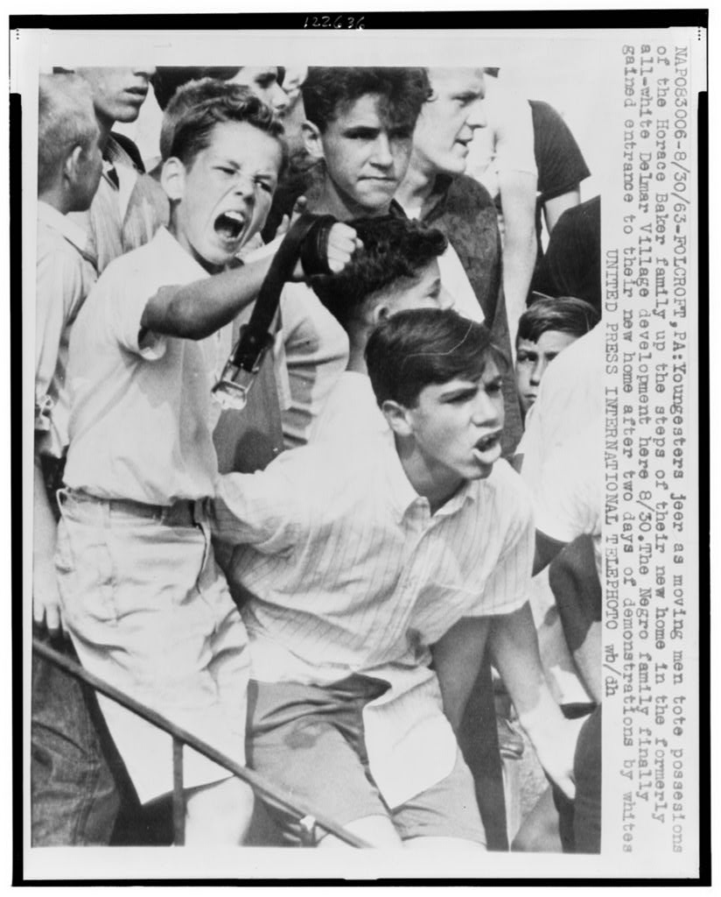
Discussion
Write several sentences about how these documents and images make you feel.

Slide 11
