Slide 1


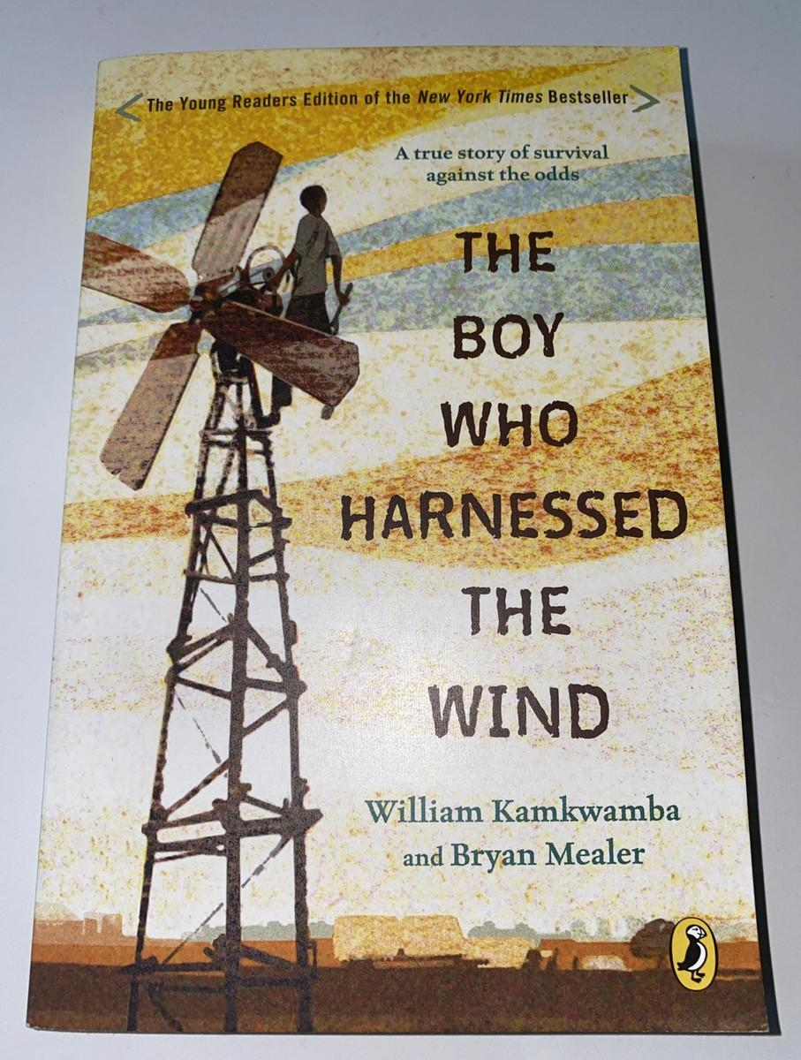
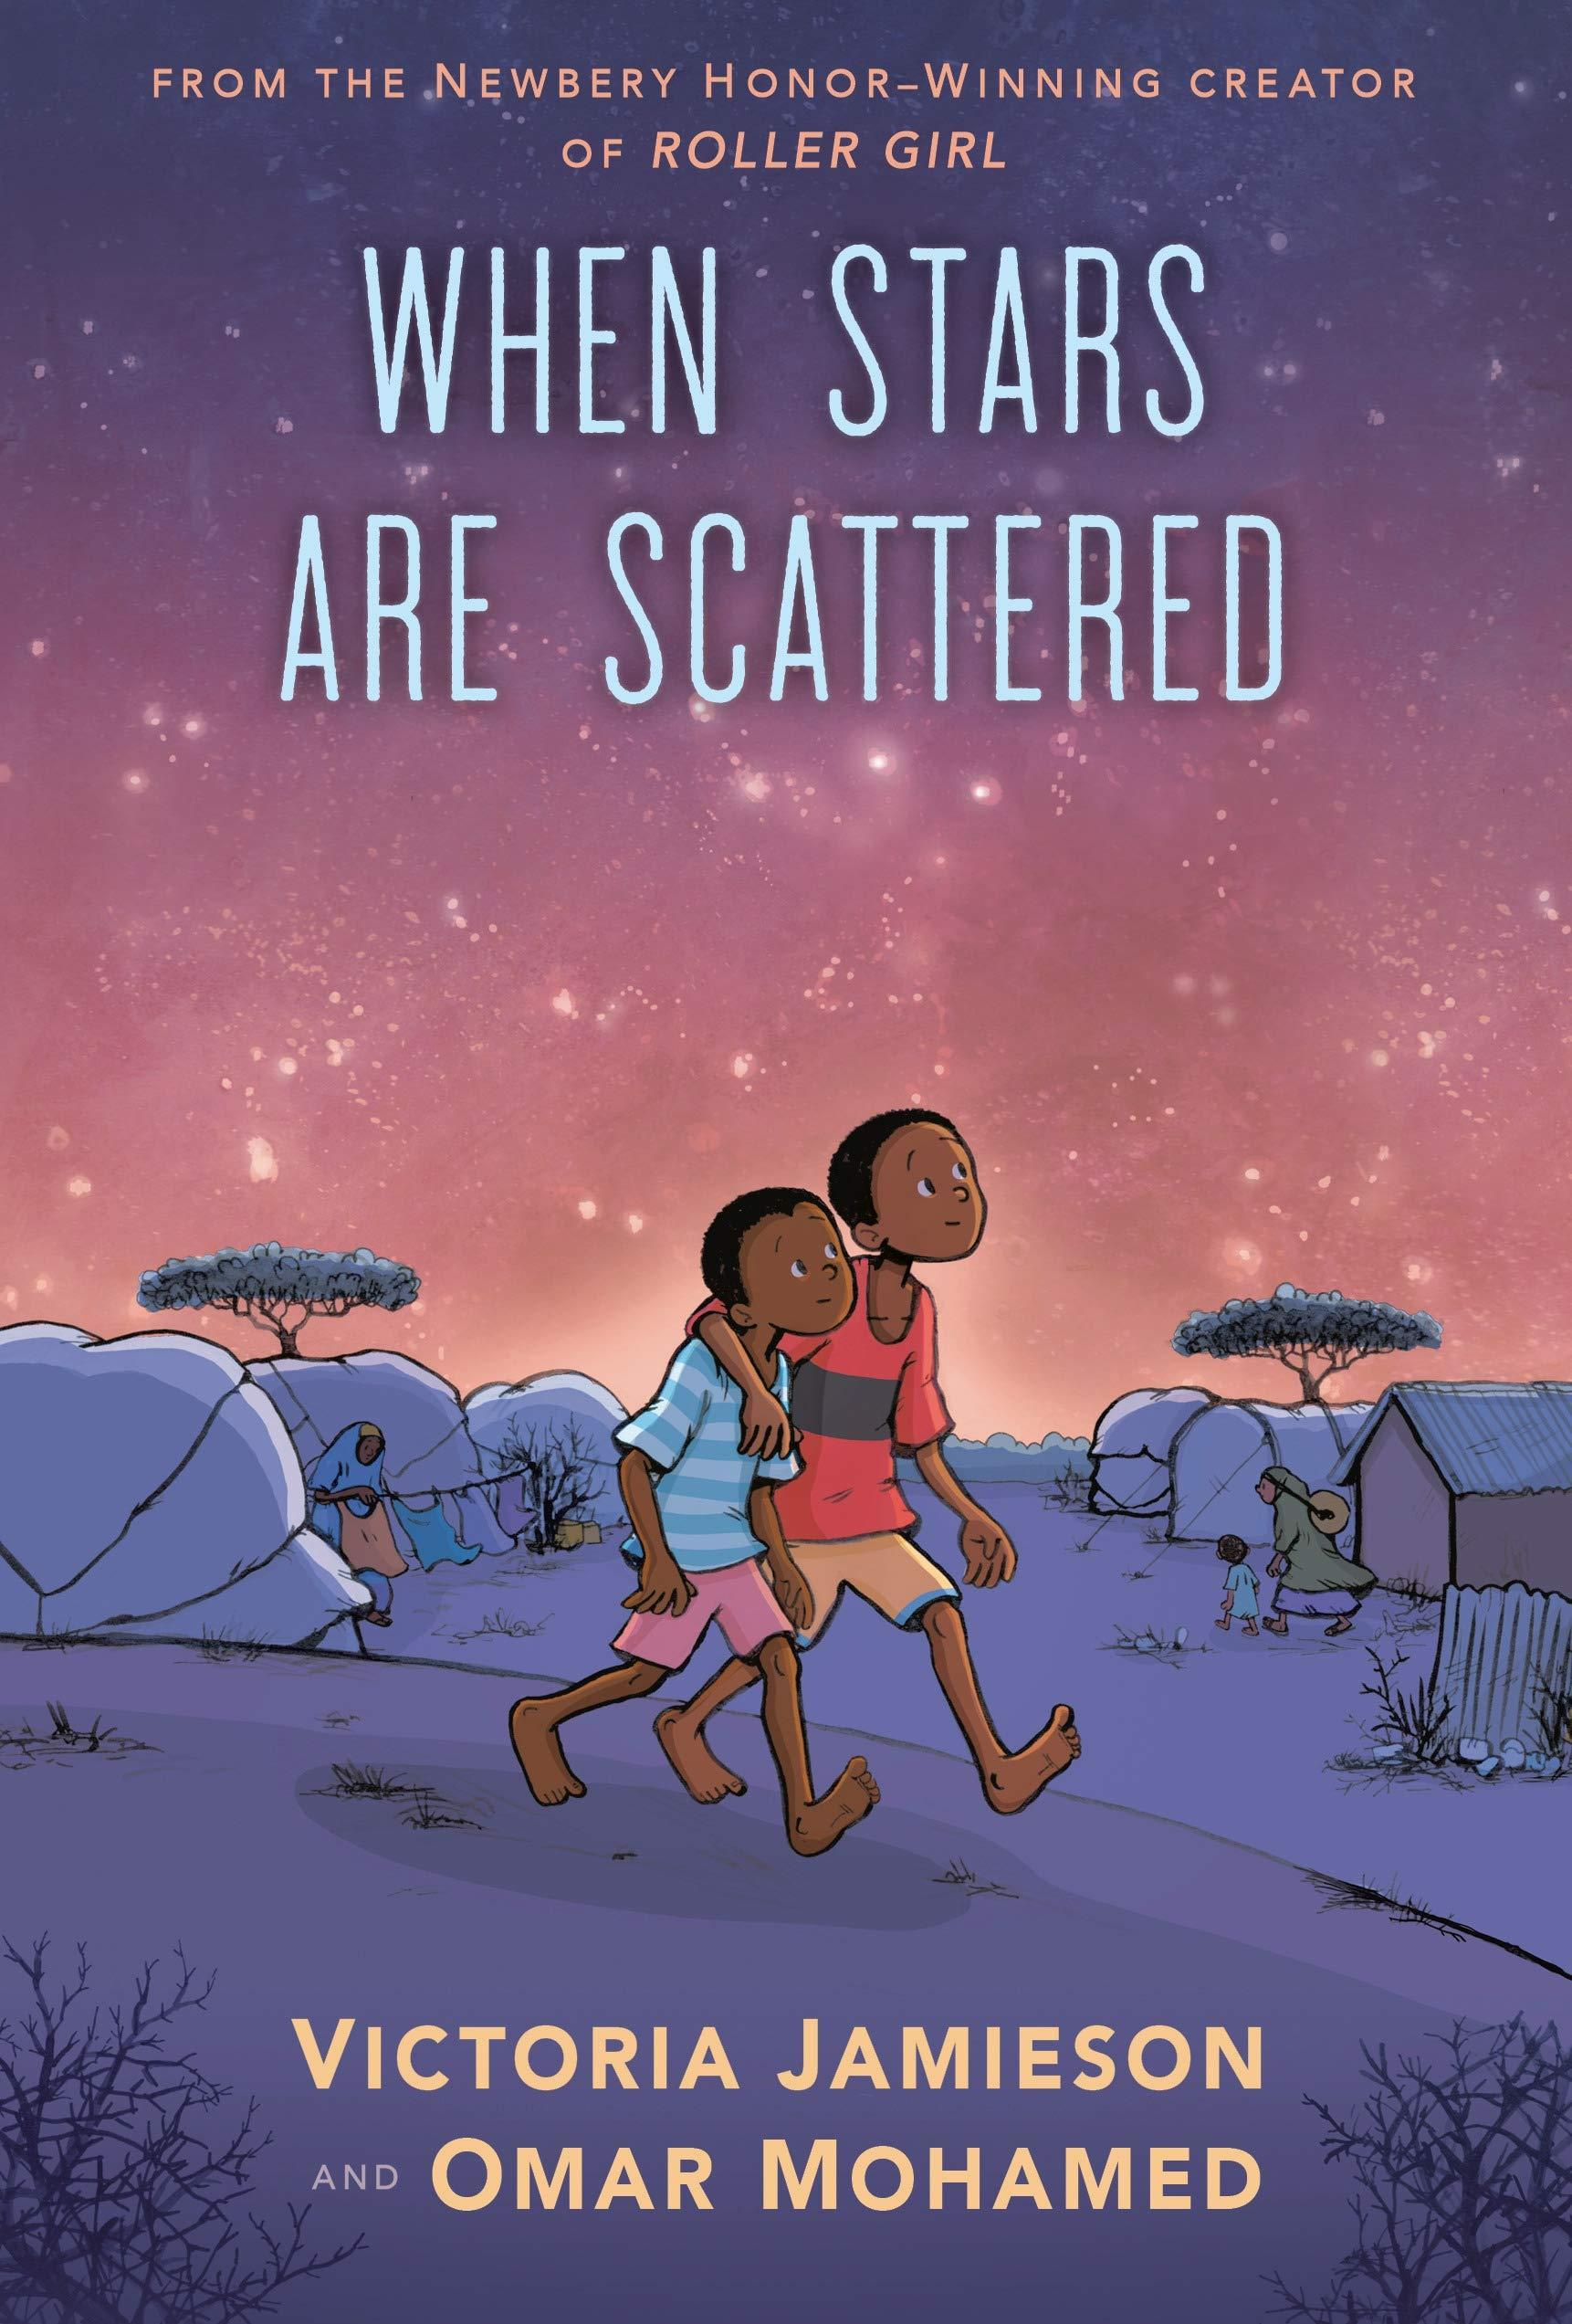
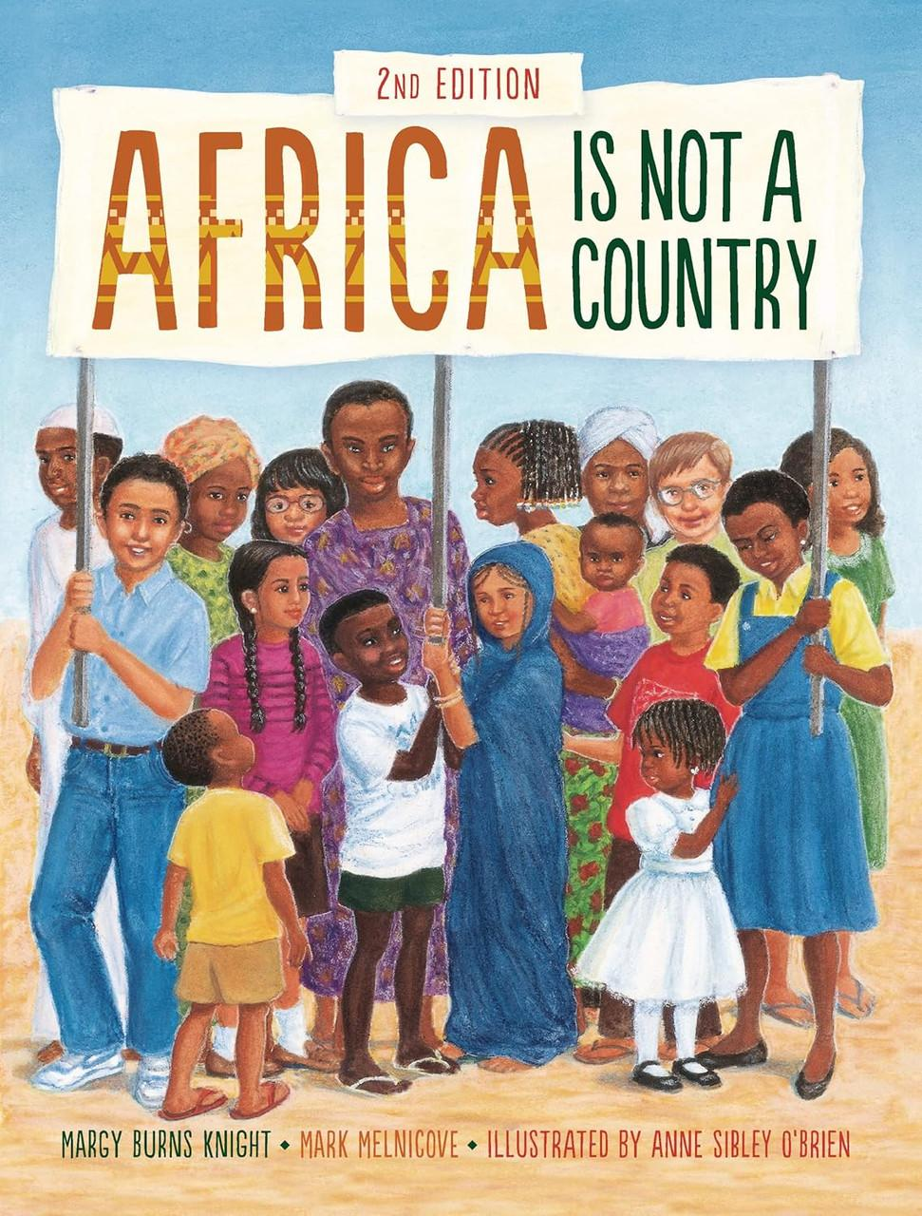
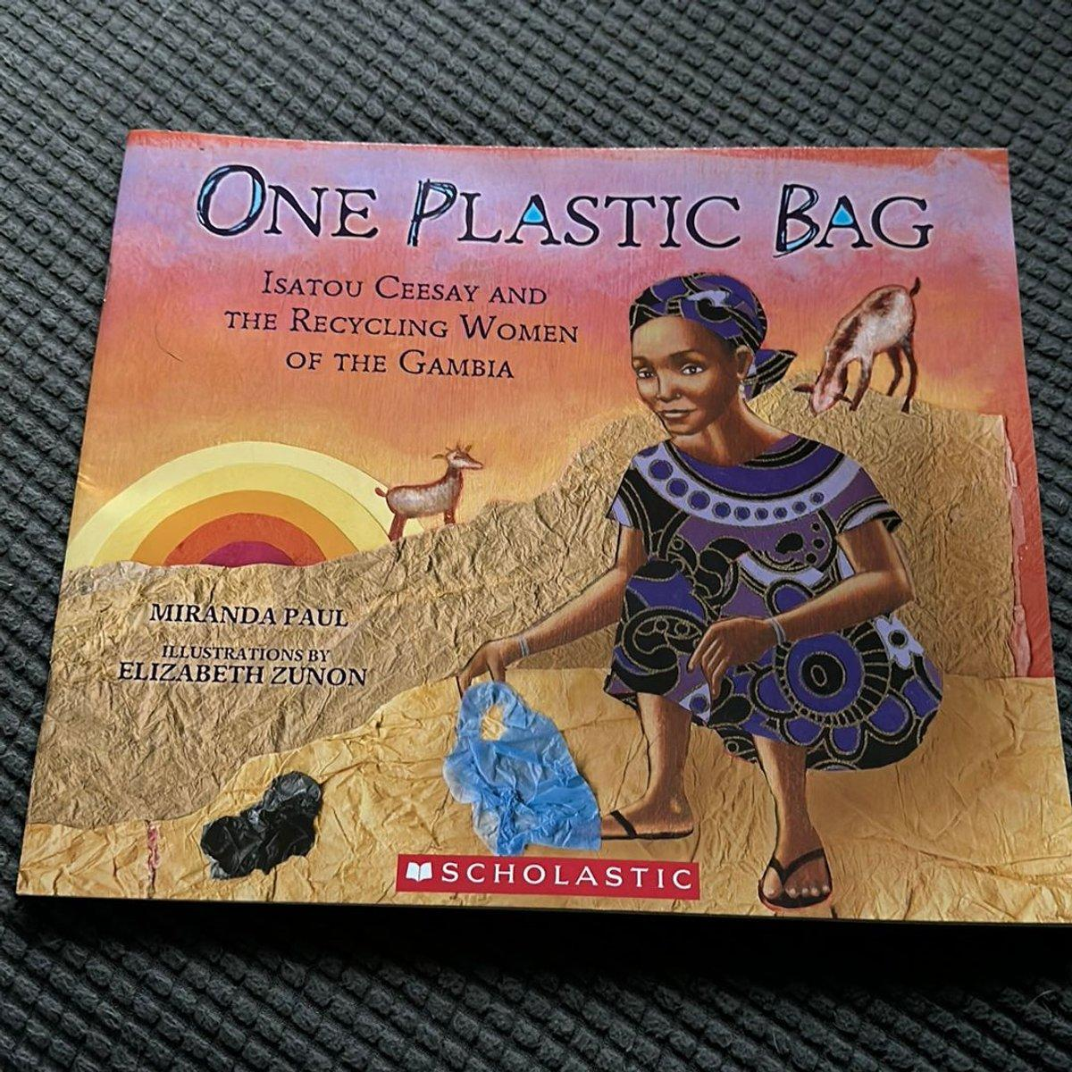



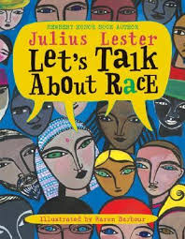


Africa Through Stories: Culture, Innovation, History, and Hope

Slide 2
Book Cover | Book Title | Author | Description & Why I chose it.
 | Africa Is Not a Country | Margy Burns Knight & Anne Sibley O’Brien | This book introduces students to the diversity of African countries, cultures, and communities. It helps readers understand that Africa is a continent with many different people, languages, and traditions.
 | One Plastic Bag | Miranda Paul | This inspiring true story follows Isatou Ceesay, a woman in The Gambia who helped her community recycle plastic bags. It teaches students about environmental responsibility, creativity, and the power of community action.
 | The Boy Who Harnessed The Windn | William Kamkwamba & Bryan Mealer | This book tells the true story of a boy in Malawi who builds a windmill to generate electricity for his family. It encourages students to explore science, innovation, problem-solving, and perseverance.
 | When Stars Are Scattered | Victoria Jamieson & Omar Mohamed | This graphic novel tells the story of two Somali brothers growing up in a refugee camp in Kenya. It helps students understand the challenges refugees face and the importance of family, friendship, education, and hope.
 | The Door of No Return | Kwame Alexander | This novel in verse follows a young boy living in nineteenth-century Ghana. It explores family, community, African history, and the historical context of the transatlantic slave trade.
Book descriptions come from Amazon

