Slide 1


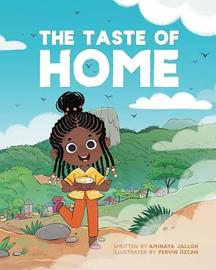
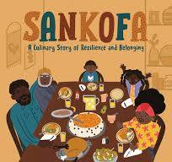
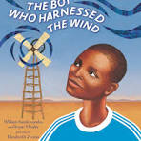
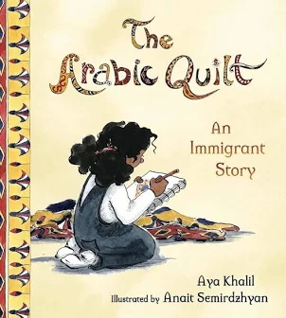


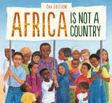

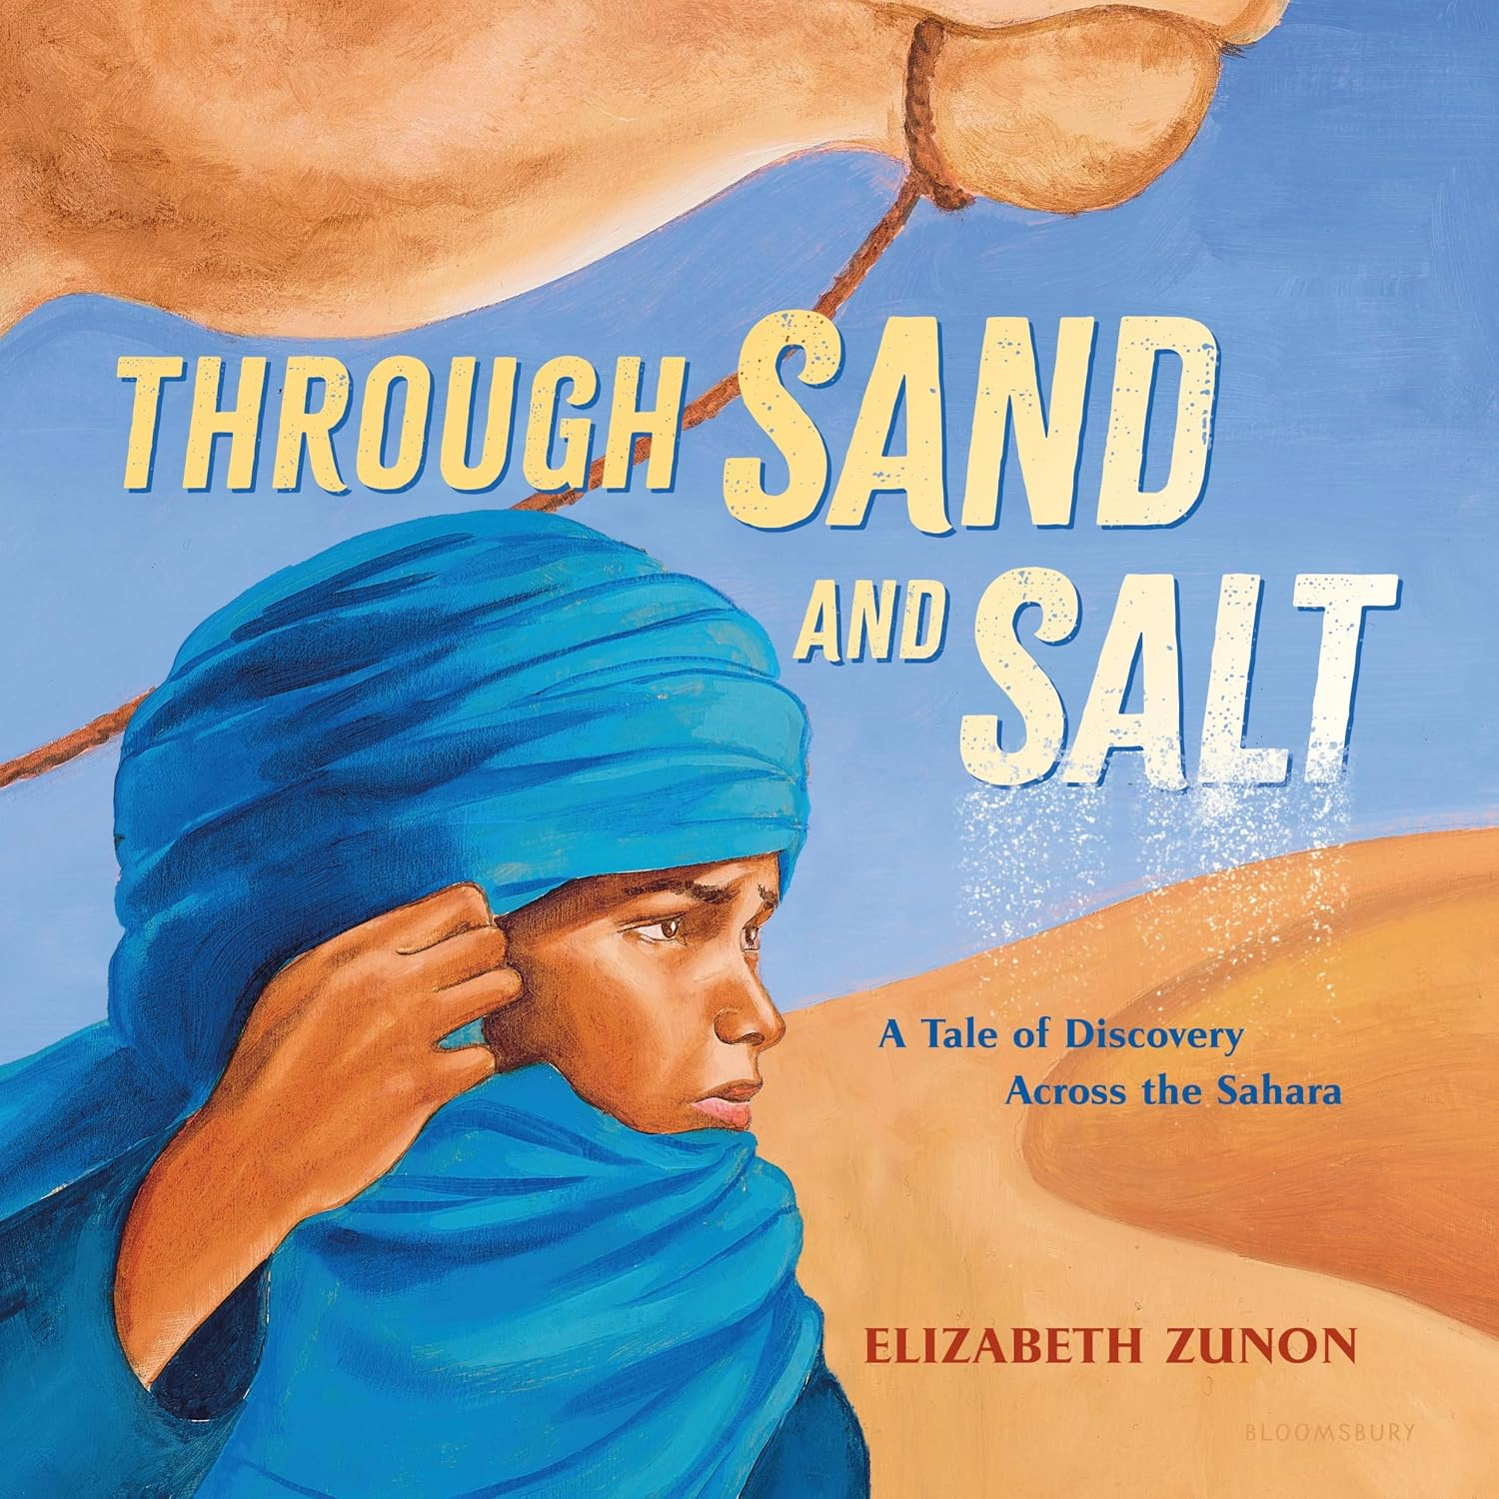

Created by Jennifer Metzler

Slide 2
Book Cover | Book Title | Author | Description & Why I chose it.
 | The Taste of Home | Aminata Jallon | Mariama has been excitedly looking forward to spending the festive December break with her family and friends in Freetown, as she does every year. However, her plans take an unexpected turn when she learns that this time around, her family is going "home" to the "village" instead! I chose this book because students relate to food and home. Both are close to their lived experiences.
 | Sankofa - A Culinary Story of Resilience and Belonging | Eric Adjepong | Based on his own experiences as a first-generation Ghanaian American growing up in New York City, chef and author Adjepong’s debut picture book beautifully captures Kofi’s complicated feelings of in-betweenness, seeing himself as not quite American enough and not quite Ghanaian enough, even as he tries to connect to his family’s history. I chose this book to be paired with The Taste of Home and to address the feeling of dual cultures.
 | The Boy Who Harnessed the Wind | William Kamkwamba | When a terrible drought struck William Kamkwamba's tiny village in Malawi, his family lost all of the season's crops, leaving them with nothing to eat and nothing to sell. William began to explore science books in his village library, looking for a solution. There, he came up with the idea that would change his family's life forever: he could build a windmill. I chose this book because the author is authentic to Malawi, it is an example of a youth taking action to solve a problem, and is an example of STEM in a real-world situation that compliments the author.
***Book descriptions come from Amazon

Slide 3
Book Cover | Book Title | Author | Description & Why I chose it.
 | The Arabic Quilt | Aya Khalil | That night, Kanzi wraps herself in the beautiful Arabic quilt her teita (grandma) in Cairo gave her and writes a poem in Arabic about the quilt. Next day her teacher sees the poem and gets the entire class excited about creating a “quilt” (a paper collage) of student names in Arabic. In the end, Kanzi’s most treasured reminder of her old home provides a pathway for acceptance in her new one. I chose this because it is an immigrant story from Egypt, involves making a quilt and gives insight to another child’s experience, encouraging empathy.
 | Through Sand and Salt - A Tale of Discovery Across the Sahara | Elizabeth Zunon | In the Sahara, salt is worth its weight in gold. When Malik is finally old enough to join his father's caravan, transporting salt across the long trade route to Timbuktu, he can't wait to prove himself worthy of this big responsibility. I chose this book because of the theme of geography, the bit of history (salt trade) and because it is written from a child’s perspective. (Also that it is a different desert than ours.)
 | Africa is Not a Country | Margy Burns Knight and Mark Melnicove | Enter into the daily life of children in the many countries of modern Africa. Countering stereotypes, Africa Is Not a Country celebrates the extraordinary diversity of this vibrant continent as experienced by children at home, at school, at work, and at play. I chose this book as it obviously is working to correct the misunderstanding that the whole of Africa is a country. It also gives diverse insights into the range of cultures within the continent.

